Slide 1

Ministry of Information and Communications
Government of Sierra Leone
Ministry of Information and Communications
Government of Sierra Leone
UPDATE ON CYBERSECURITY IN SIERRA LEONE

Slide 2
Overview of Presentation
National Cybersecurity Strategy
Computer Incidence Response Teams (CSIRT)
Critical Infrastructure Protection (CIP)
Legislation and Legal Frameworks
Cybersecurity awareness, skills and workforce development

Slide 3
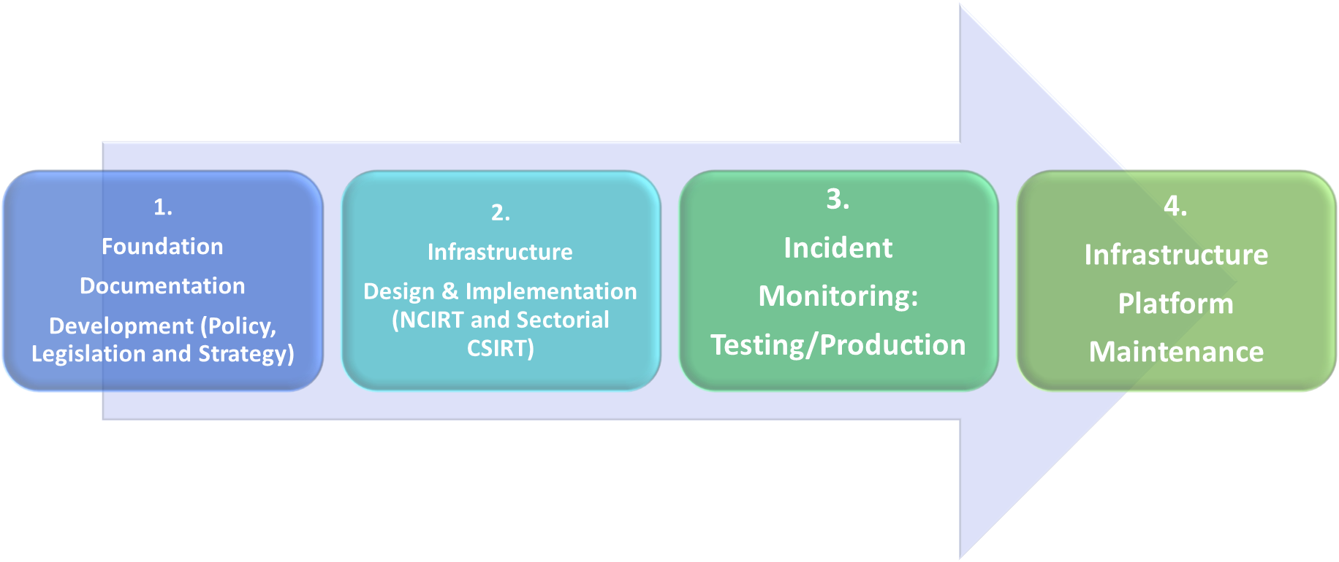

WAY-FORWARD
STATUS
National Awareness Raising
MOT/IM Team Five - Polytechnic Institute of NYU - Organization Behavior

Slide 4
National Cybersecurity Strategy
5-year Cybersecurity Strategy (2021 -2025) developed and approved by Cabinet in March 2021.
Create Institutional, Legal & Regulatory Frameworks for Effective Governance
Promote Public Education and Awareness , Child Online Protection, Rights & Privacy of Citizen
Develop Cyber Capabilities to support National Security Objectives
Protect Critical Digital Infrastructure through Response Readiness
Strenthen National, Regional, & International Cooperation
National Cybersecurity Strategy
The Strategy is geared towards a “credible and secured cyberspace that protects national interests while empowering citizens with the freedom to safely use the Internet for the socio-economic benefit of the nation”.
Currently, the Ministry is in the implementation phase

Slide 5
CSIRT
Sierra Leone is a beneficiary of the establishment of a standard nCSIRT under the OCWAR-C Project
Based on the 2021 Cybersecurity and Crime Law, it will be a department under the Cybersecurity Coordination Centre
Hosted on the 5th Floor of the new NATCOM (Communication Regulator) Building
Staff provided by the Ministry of Information and Communications
Training on the basic principles and technical capabilities already started with full support from OCWAR-C

Slide 6
CSIRT
Vision 2022
Operationalising the NCSIRT
Developing and popularising cyber incidence response framework, which will provide general guidelines and procedures of the operation of CSIRTS
Establishing and operationalising 3 sectorial CSIRTS (Initiated conversations with NATCOM, Bank of Sierra Leone and ONS)
Establishing a secured incident reporting platform for sharing of incidents and also threat intelligence across sectors or institutions

Slide 7
Critical Infrastructure Protection
In 2020, conducted a National Cyber Risk Assessment (NCRA) of four (4) pivotal sector; financial, government, energy and Telecoms
Vision 2022
Conduct another NCRA iteration to verify our CNIIs
Developing a Risk Register
Develop clearly defined roles and responsibilities for all CNII
Establish a mechanism for regular vulnerability disclosure and information sharing between Government and CNII operators

Slide 8
Legislation and Legal Framework
2021 Cybersecurity and Crime Act passed through Parliament and currently awaiting President’s signature
Drafted the Data Protection Bill and associated regulations; currently planning a stakeholder engagement for validation.
TOT conducted by OCWAR-C Project for 3 personnel in the criminal justice system on the basics of cybercrime and the implementation of the law

Slide 9
Legislation and Legal Framework
VISION 2022
Specialised training programs for judges, prosecutors, lawyers and the law enforcement officials
Capacitate the national forensic lab at the CID
Domesticating ECOWAS directives on related to cybersecurity and acceding to the Budapest Convention
Enhance Sierra Leone’s diplomatic competencies in cyber-related issues

Slide 10
Cybersecurity Awareness, Skills and Workforce Development
Train CSOs and Media on the Cybersecurity landscape and threats
Conducted various stakeholder’s engagement
Sierra Leone started celebrating the "Safer Internet Day" in 2019 as a way of sensitizing the public on responsible use of the internet.

Slide 11
Cybersecurity Awareness, Skills and Workforce Development
VISION 2022
Develop information sharing platforms that cater to the needs of children within different age brackets
Launch a dedicated Cybersecurity awareness month
Run campaigns that promote good cyber hygiene
Create cybersecurity education programmes for teachers/lectures
Identify training needs and develop appropriate training modules for government and CNII operators

Slide 12
THANK YOU FOR YOUR ATTENTION
MOT/IM Team Five - Polytechnic Institute of NYU - Organization Behavior

